Slide 1
An approach: Airlines service feedback using Sentiment Analysis
Anuj Khasgiwala
Shobhit Mundra

Slide 2
Problem Statement

Slide 3
Difficult to gather passengers feedback taken by airlines using online surveys and questionnaires
Content investigation on the feedback of the tweets to discover the principle explanation for the customer’s positive/impartial/negative conclusions

Slide 4
Evaluation Methods

Slide 5
Collecting Dataset
Scrapping the recent tweets from twitter
Data cleansing and pre-processing
Applying sentiment analysis on recent tweets
Visual Analysis
Topic Modelling

Slide 6
Collecting Dataset

Slide 7
Data set was collected from Kaggle for 2015 dataset
Used ‘tweepy’ library for extracting the dataset from Twitter for 2017 dataset
Removed ‘#’, ‘@’ and hyperlinks using ‘re’ of python

Slide 8
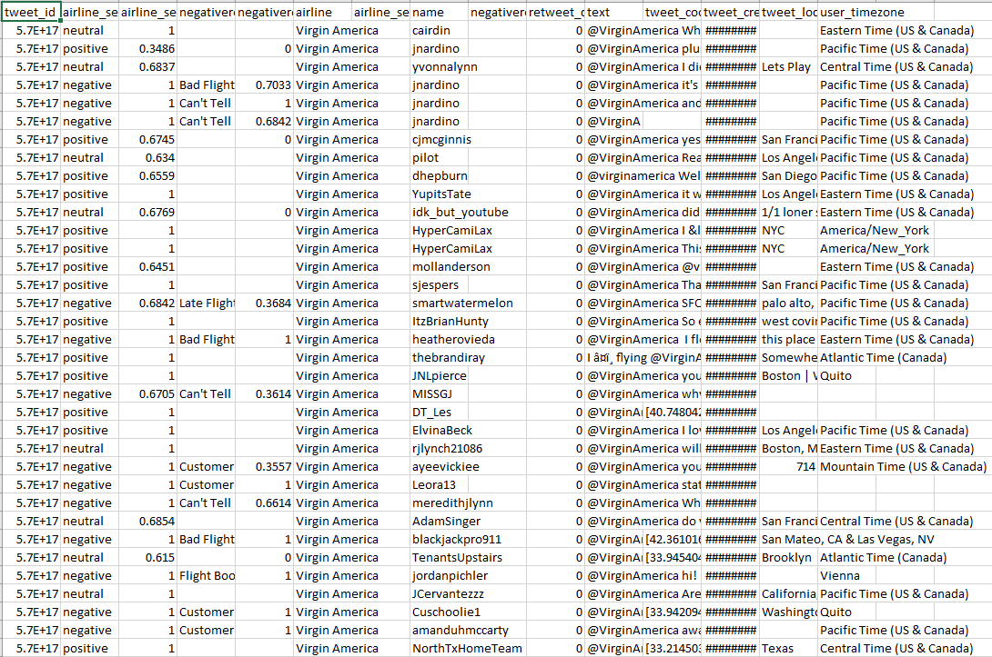
2015 Tweets

Slide 9
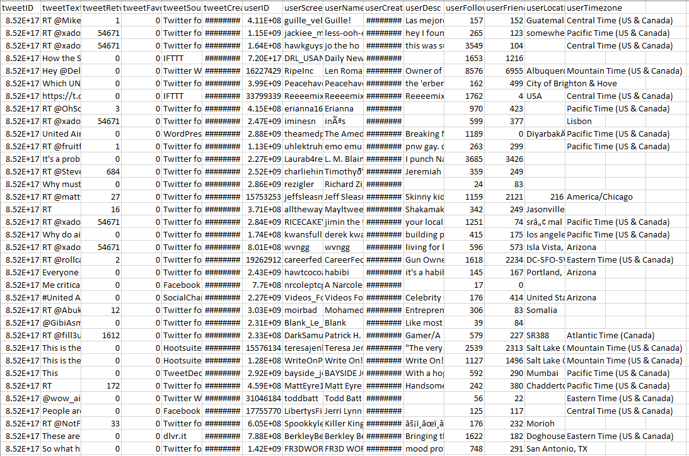
2017 Tweets

Slide 10
Sentiment Analysis

Slide 11
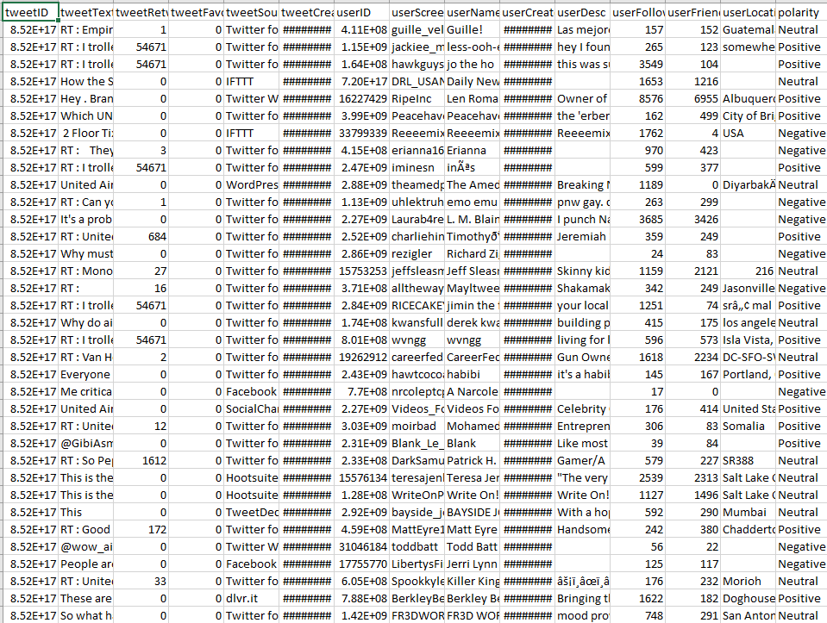
Sentiment Analysis on 2017 Tweets

Slide 12
Analysis

Slide 13
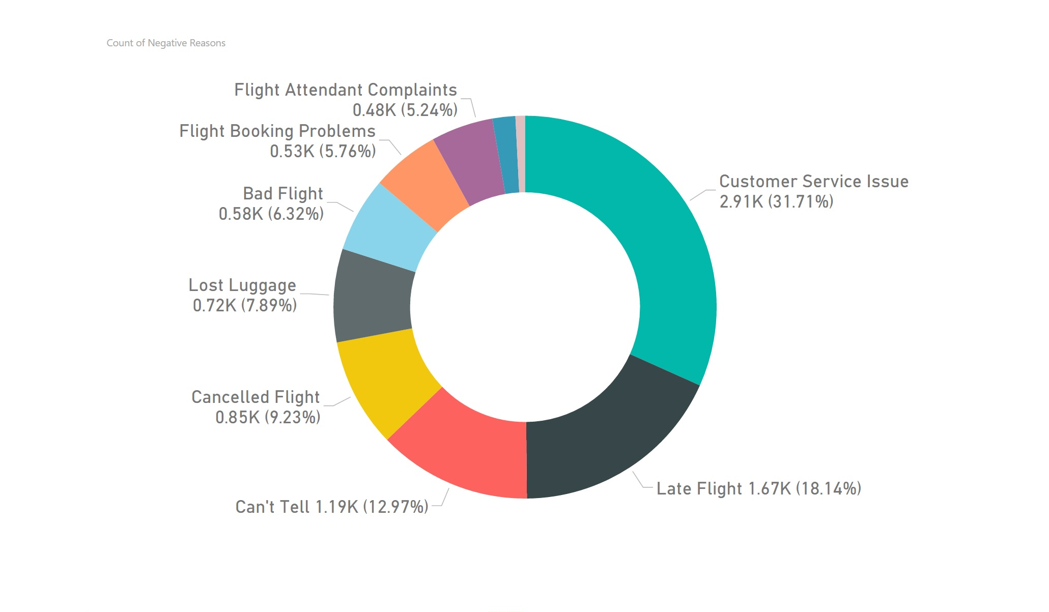

Slide 14
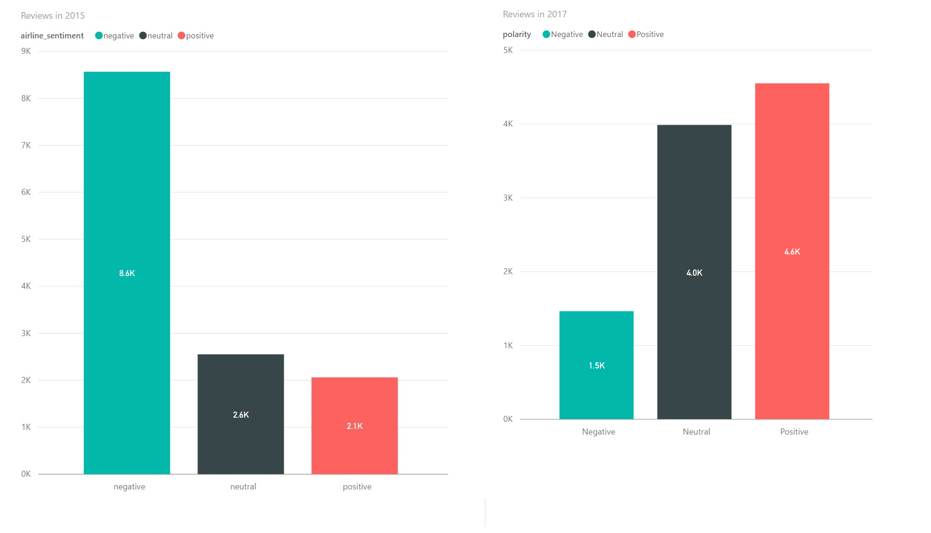

Slide 15
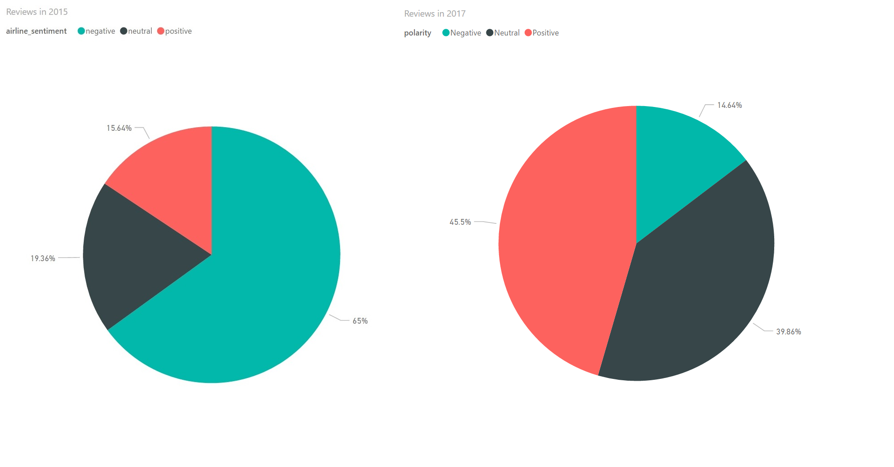

Slide 16
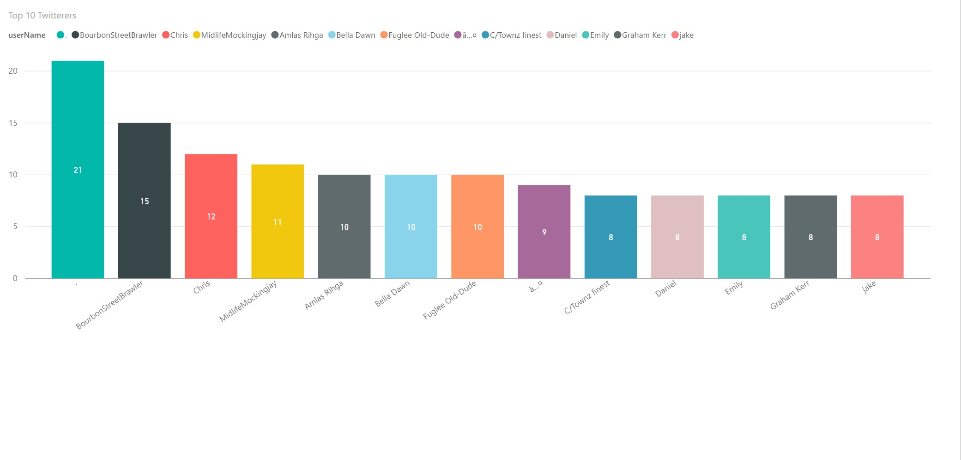

Slide 17
Topic Modelling

Slide 18
NNMF/NMF

Slide 19

Introduction
Matrix in mathematics and components
Basic matrix operations
Matrix Factorization
Finding 2 smaller matrices with k-dimensional features
P & Q are of n x k and m x k such that product approximates R

Slide 20
Factored Matrices
P
Features matrix
Row for feature, column for column in R
Q
Weights matrix
Column for weights, row for row in R
Dot product, to find sum of latent features by weights for each element

Slide 21
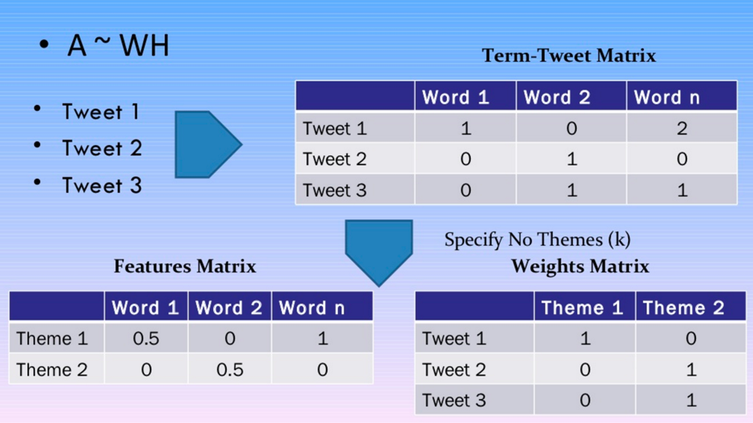

Slide 22
Non-negative
Returns non negative features and weights values
Clustering
Closely related to Supervised and Unsupervised, but closely to other clustering

Slide 23
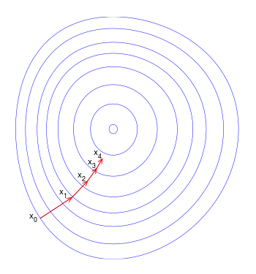
Gradient Descent
Attempts to minimize error
Calculate error using squared error(actual-predicted)²
Calculate gradient to figure out which direction to go to minimize error.
Repeat step till there is no more error

Slide 24
Algorithm
Initialize P & Q with random small numbers
loop until max_steps:
loop row, col in R:
If R[row][col] > 0:
Compute error of element
Compute gradient from error
Update P & Q with new entry
Compute total error
If error < threshold:
break
return P, Q^{T}

Slide 25

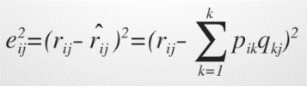
Computation
Compute predicted element(dot product of row & col in P & Q)
Compute squared error
Find gradient by taking differential of error for each element
Update each element in P & Q using learning rate α. Α is usually small, because step size is too large, we can miss minimum.
Converge once sum of errors reaches threshold.

Slide 26
Useful
Ambiguous attributes or weak predictability
Text mining
Image analysis and Computer Vision
Social Network

Slide 27
LDA vs NNMF
Similarity | Difference
Both return documents that belong to topic and words belonging to topic | Differing mathematical underpinning
Take bag of words matrix as input | LDA is based on probabilistic graphical modeling while NMF is based on linear algebra

Slide 28
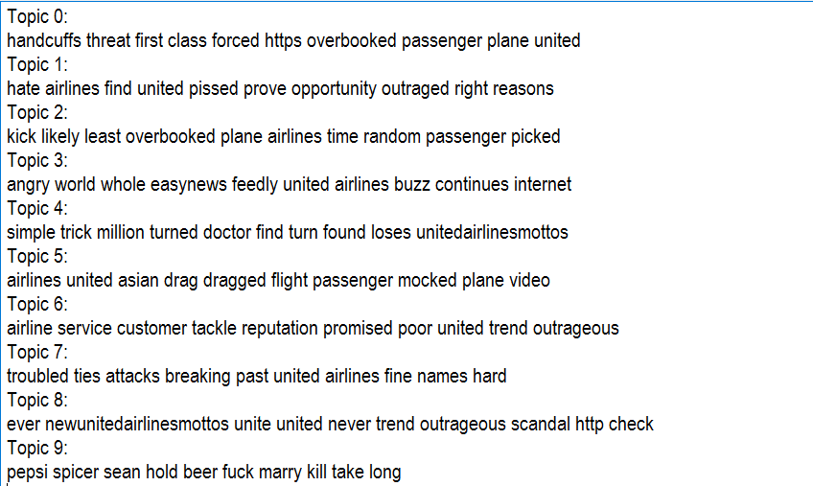
Top 10 Negative Topics

Slide 29
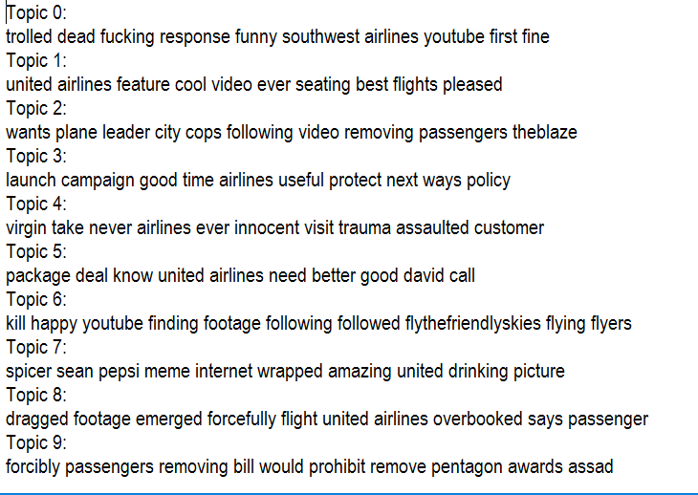
Top 10 Positive Topics

Slide 30
Thank You

Slide 31
Questions??

